Slide 1
Module Six: Service Engineering

Slide 2
SOA Lifecycle

Slide 3
Service Engineering
also called service-oriented software engineering
a software engineering process that attempts to decompose the system into self-running units that either perform services or expose services

Slide 4
SOA lifecycle
A series of steps that need to be completed to construct the services for a given service-oriented solution.
The basic SOA lifecycle consists of a series of phases similar to those used for regular development projects
SOA introduces unique considerations in every phase of service construction and delivery

Slide 5
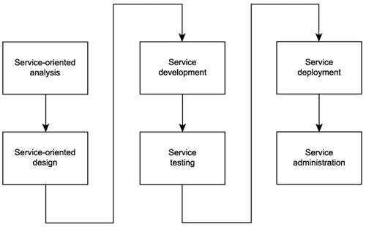
Common phases of an SOA delivery lifecycle

Slide 6
Service-oriented analysis
In this initial stage that we determine the potential scope of our SOA
Service layers are mapped out
Individual services are modeled as service candidates that comprise a preliminary SOA

Slide 7
Service-oriented design
When we know what it is we want to build, we need to determine how it should be constructed.
Service-oriented design is a heavily standards-driven phase that incorporates industry conventions and service-orientation principles into the service design process.
This phase, therefore, confronts service designers with key decisions that establish the hard logic boundaries encapsulated by services. The service layers designed during this stage can include the orchestration layer, which results in a formal business process definition.

Slide 8
Service development
The actual construction phase.
Development platform-specific issues come into play, regardless of service type.
The choice of programming language and development environment will determine the physical form services and orchestrated business processes take, in accordance with their designs.

Slide 9
Service testing (1)
Given their generic nature and potential to be reused and composed in unforeseeable situations, services are required to undergo rigorous testing prior to deployment into a production environment.

Slide 10
Service testing (2)
Some of the key issues facing service testers:
What types of service requestors could potentially access a service?
Can all service policy assertions be successfully met?
What types of exception conditions could a service be potentially subjected to?
How well do service descriptions communicate service semantics?
Do revised service descriptions alter or extend previous versions?

Slide 11
Service testing (3)
Some of the key issues facing service testers:
How easily can the services be composed?
How easily can the service descriptions be discovered?
Is compliance to WS-I profiles required?
What data typing-related issues might arise?
Have all possible service activities and service compositions been mapped out?
Have all compensation processes been fully tested?

Slide 12
Service testing (4)
Some of the key issues facing service testers:
What happens if exceptions occur within compensation processes?
Do all new services comply with existing design standards?
Do new services introduce custom SOAP headers? And, if yes, are all potential requestors (including intermediaries) required to do so, capable of understanding and processing them?
Do new services introduce functional or QoS requirements that the current architecture does not support?

Slide 13
Service deployment (1)
Installing and configuring distributed components, service interfaces, and any associated middleware products onto production servers.

Slide 14
Service deployment (2)
Typical issues that arise during this phase include:
How will services be distributed?
Is the infrastructure adequate to fulfill the processing requirements of all services?
How will the introduction of new services affect existing services and applications?
How should services used by multiple solutions be positioned and deployed?
How will the introduction of any required middleware affect the existing environment?

Slide 15
Service deployment (3)
Typical issues (cont):
Do these services introduce new versions of service descriptions that will need to be deployed alongside existing versions?
What security settings and accounts are required?
How will service pools be maintained to accommodate planned or unforeseen scalability requirements?
How will encapsulated legacy systems with performance or reliability limitations be maintained and monitored?

Slide 16
Service administration
After services are deployed, standard application management issues come to the forefront.
Issues frequently include:
How will service usage be monitored?
What form of version control will be used to manage service description documents?
How will messages be traced and managed?
How will performance bottlenecks be detected?

Slide 17
SOA Delivery Strategies

Slide 18
SOA delivery strategies
Different strategies exist for how to organize lifecycle stages to enable delivery of specialized service layers
Top-down
Bottom-up
Agile (meet-in-the-middle)

Slide 19
Top-down strategy
"analysis first" approach
Promotes the formal definition of corporate business models prior to modeling service boundaries

Slide 20
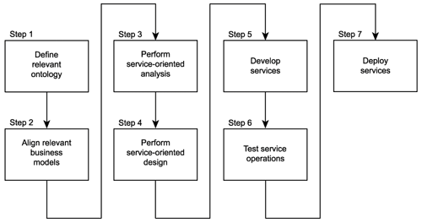

Slide 21
Top-down strategy benefits and weaknesses
It can result in highest quality level of SOA
Significant volume of up-front analysis work

Slide 22
Bottom-up strategy
This approach encourages the creation of services as a means of fulfilling application-centric requirements.
Based on the delivery of application services on an “as needed” basis
Integration is the primary motivator for bottom-up designs, where the need to take advantage of the open SOAP communications framework can be met by simply appending services as wrappers to legacy systems.

Slide 23
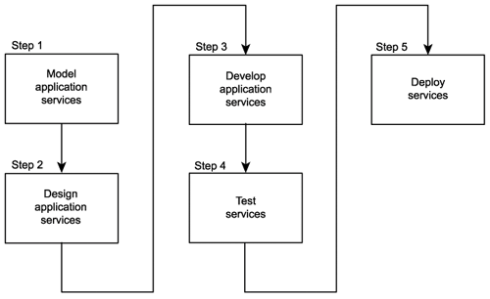

Slide 24
Bottom-up strategy benefits and weaknesses
Easy to follow
Does not result in the advancement of service-orientation

Slide 25
Agile strategy
A combination of top-down and bottom-up approaches
Business-level analysis occurs concurrently with service design and development

Slide 26
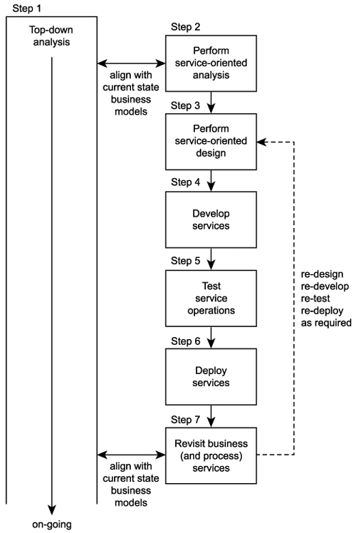

Slide 27
Agile strategy benefits and weaknesses
On-going analysis is supported, while allowing immediate delivery of service
As analysis progresses, existing services are revisited and revised as required
More complex - it needs to fulfill two opposing sets of requirements
Increased effort associated with the delivery of every service
services may need to be revisited, redesigned, redeveloped, and redeployed

